Slide 1
PA4 File Encoding
Create a menu driven system that will give the user an option to:
  Encode a file
  Decode a file
  Count the words in a file
  Exit the system

Slide 2
Encode a File
The system should prompt the user for the file name to encode
Encoding should be done using the provided key and a ROT-42 algorithm
The system should prompt the user for the file name to store the encoded file

Slide 3
Decode a File
The system should prompt the user for the file name to decode
Decoding should be done using the provided key and a ROT-42 algorithm
The system should prompt the user for the file name to store the decoded file

Slide 4
Word Count a File
The system should prompt the user for the file name
Count the total number of words in the file
Display the word count to the user on the console

Slide 5
Deliverables
Turn in to blackboard
  IPO or Flowchart for the application
  .cs program file

Slide 6
Grading – Worth 90 Points
Deliverable | Amount
Design Docs | 10
Encoding | 15
Decoding | 15
Word Count | 15
Menu / Flow of Control | 10
Efficient, well structured, properly commented code is worth an additional 10 points
Extras can bring grade up to a total of 120%.

Slide 7
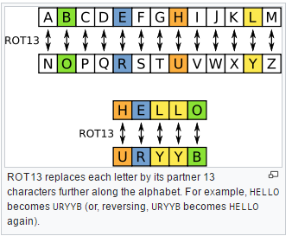
Example ROT System
* Source Wkipedia.com

Slide 8
Possible Extras
Take a count of the total number of characters in a file
Take a count of each character in a file (# of "a")
Take a count of each repeated word in a file(# of "the")
File handling (writing code that will create a new file and store a custom message in the new file)
***Remember to make a note of any extras that you include at the TOP OF YOUR CODE so that the TA’s won’t miss any of them!!!***
An Introduction to Programming with C++, Seventh Edition

